Slide 1

RUNGTA COLLEGE OF DENTAL SCIENCES AND RESEARCH
BLEEDING DISORDERS
DEPARTMENT OF GENERAL MEDICINE

Slide 2
SPECIFIC LEARNING OBJECTIVES
MUST KNOW | NICE TO KNOW | DESIRE TO KNOW
MECHANISM | DIAGNOSIS | HEREDITARY
HEMOPHILIA | LAB TEST | ACQUIRED
VON WILLEBRAND’S DISEASE |  | ACUTE PROMYELOCYTIC LEUKEMIA
THERAPY
TREATMENT

Slide 3
CONTENTS
INTRODUCTION
MECHANISM OF BLEEDING
KEY TO DIAGNOSIS
HISTORY
HEREDITARY
ACQUIRED
LAB TEST
ACUTE PROMYELOCYTIC LEUKEMIA
HEMOPHILIA
TREATMENT
VON WILLLEBRAND’S DISEASE
TREATMENT
THERAPIES
LIVER DISEASE VS DIC
SUMMARY

Slide 4
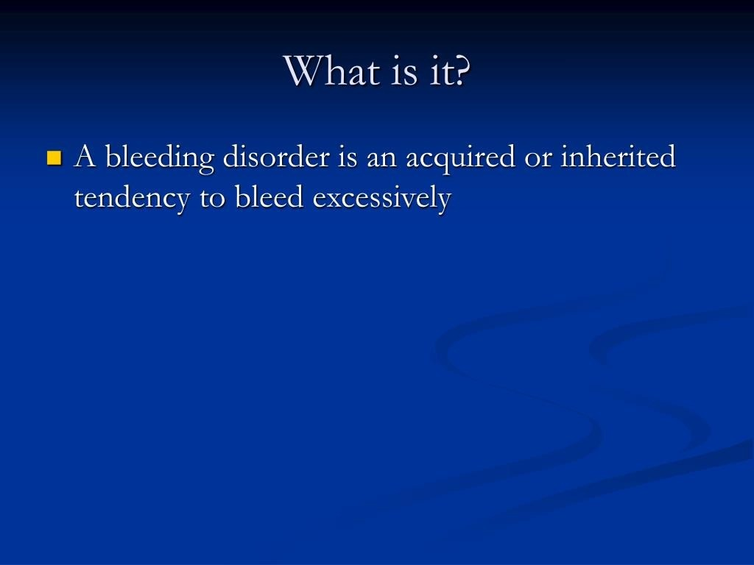

Slide 5
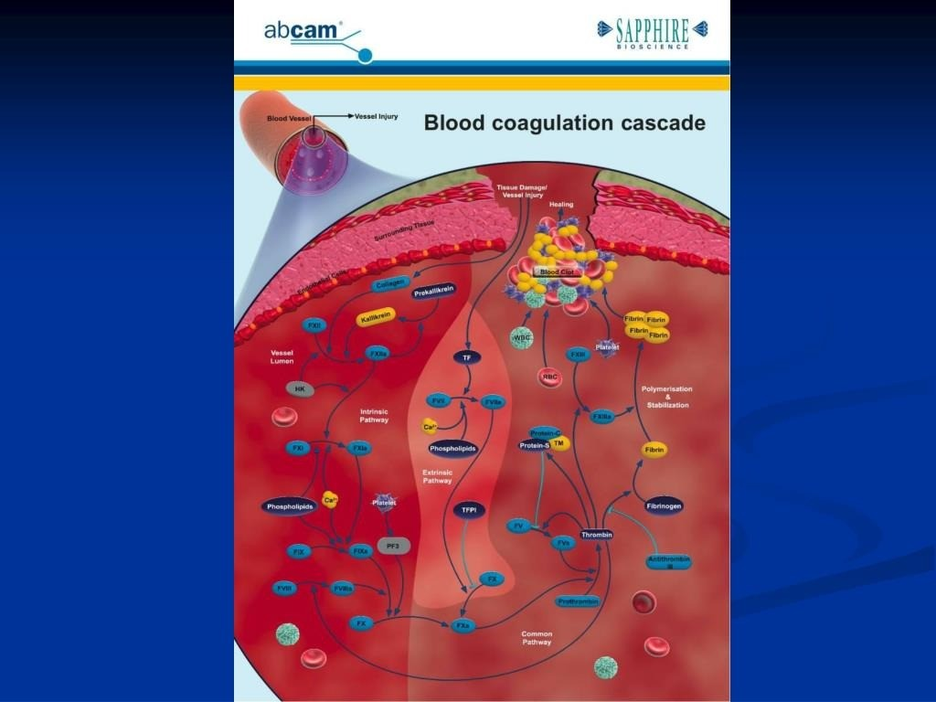

Slide 6
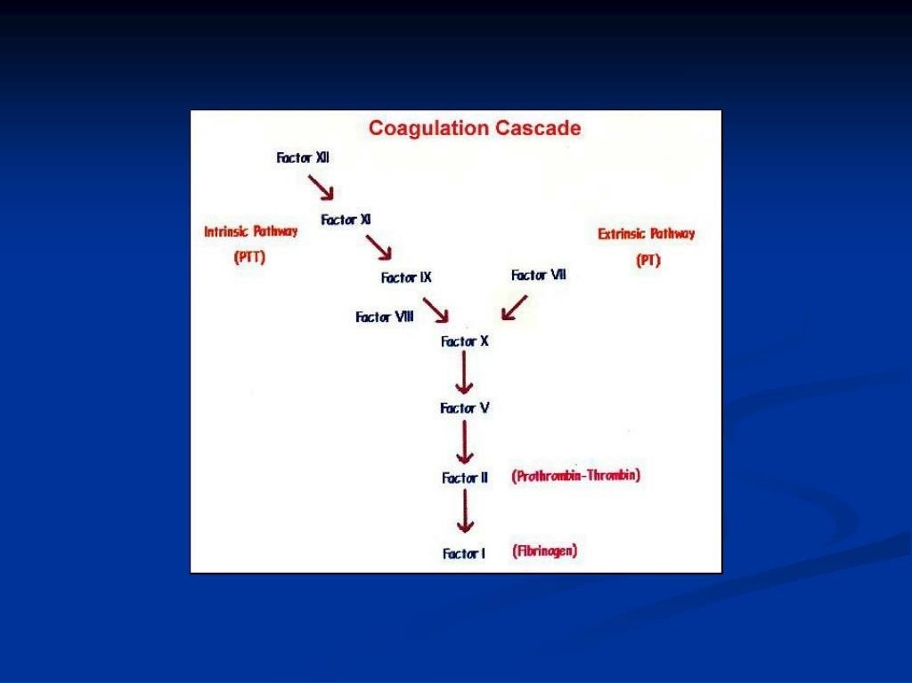

Slide 7
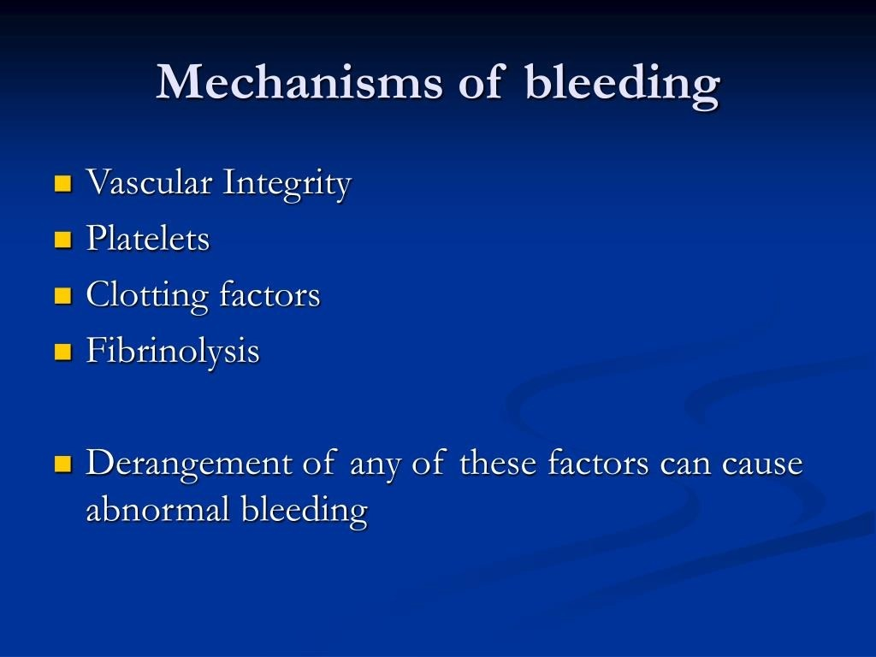

Slide 8
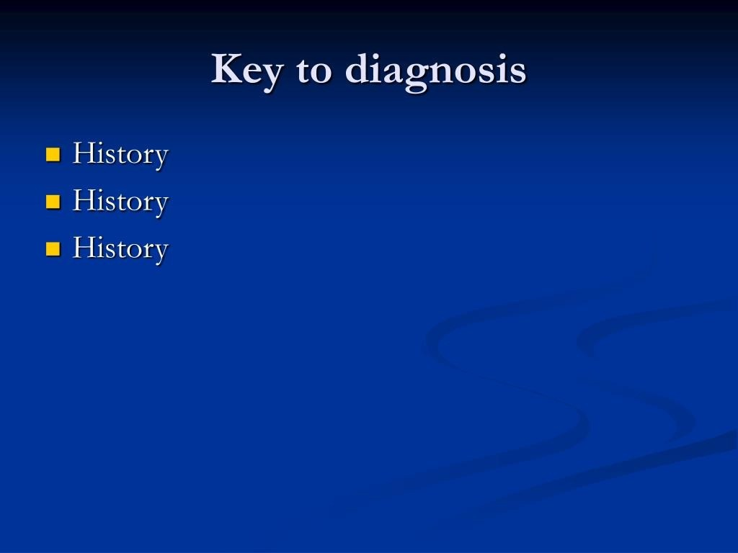

Slide 9
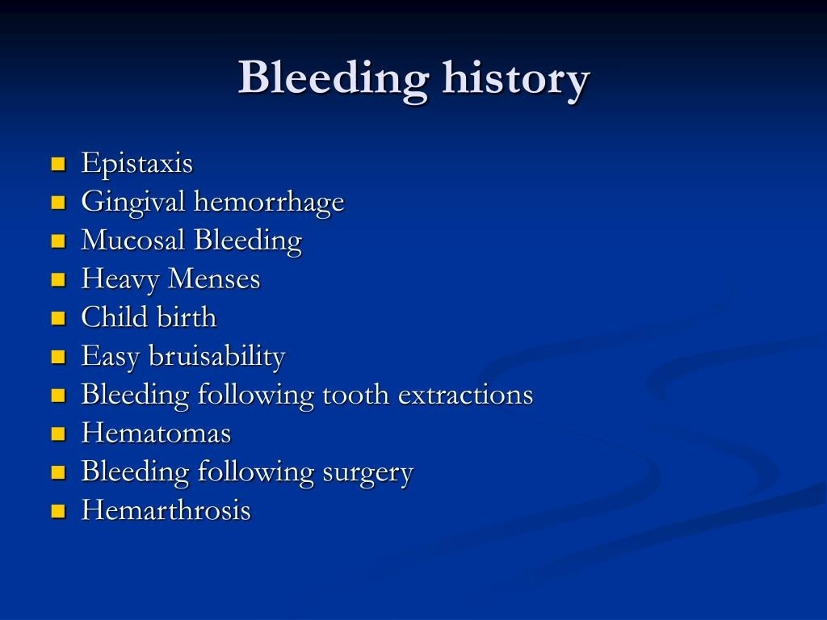

Slide 10
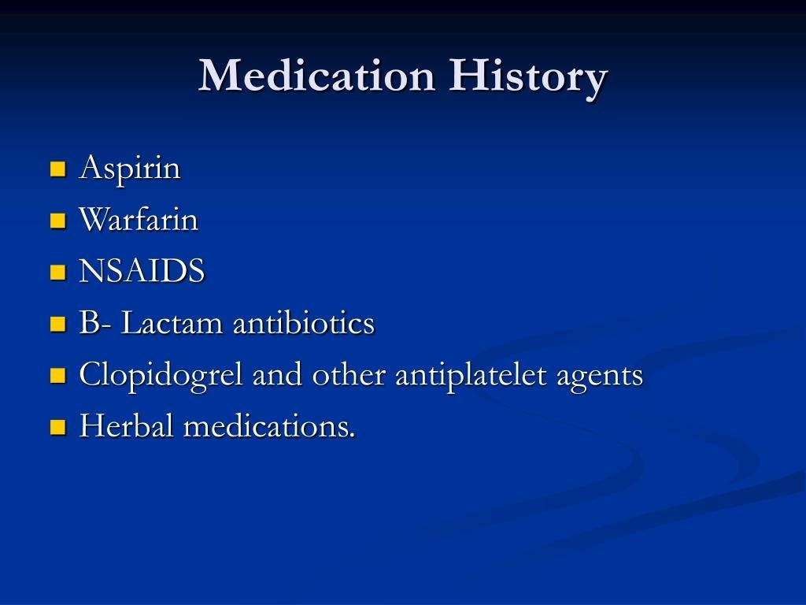

Slide 11
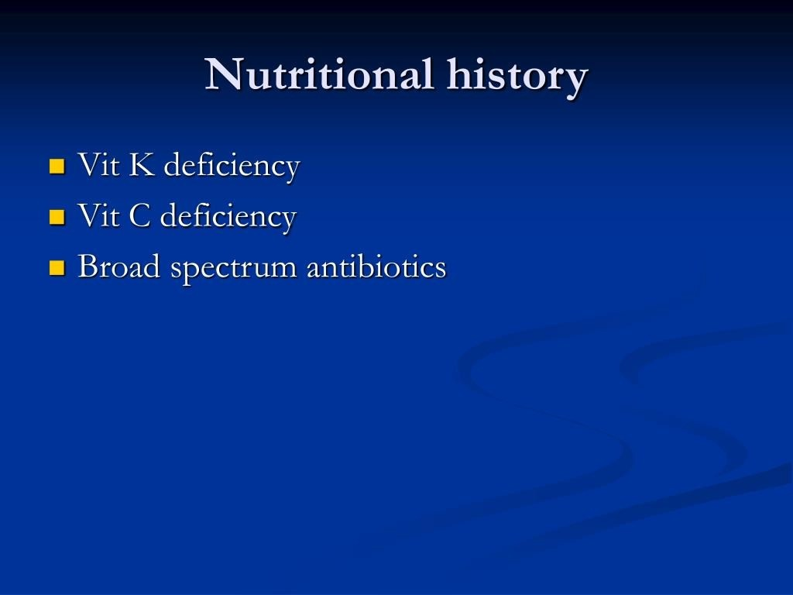

Slide 12
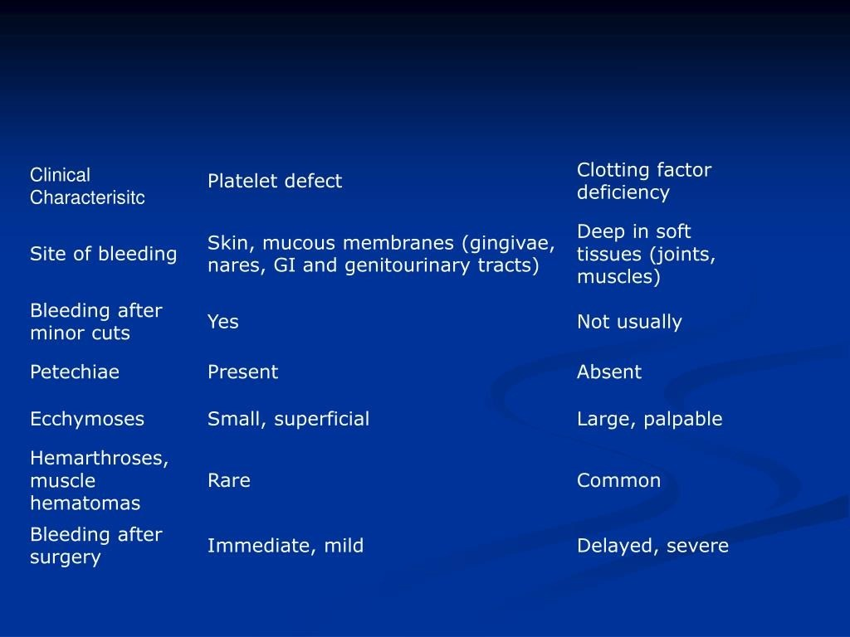

Slide 13
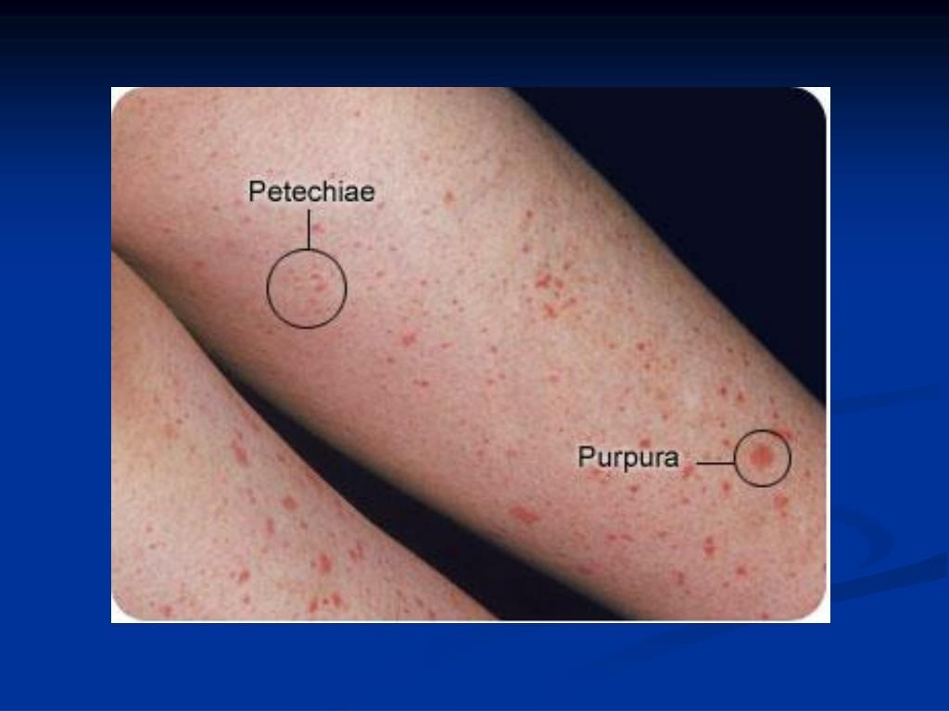

Slide 14
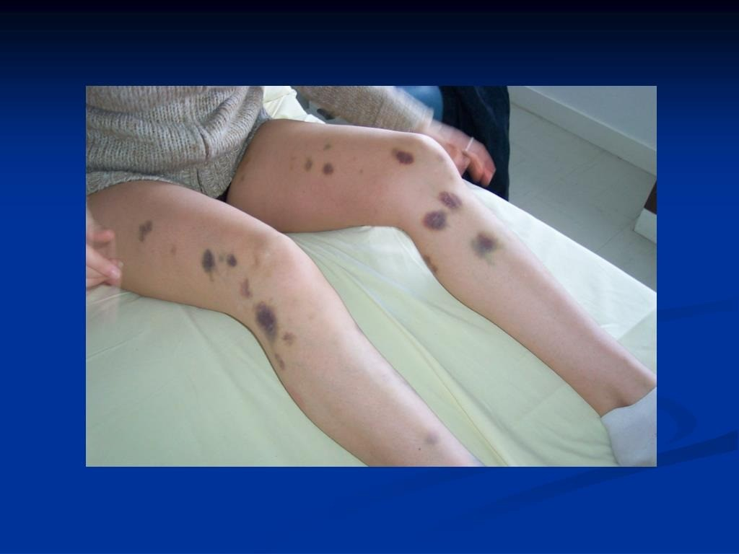

Slide 15
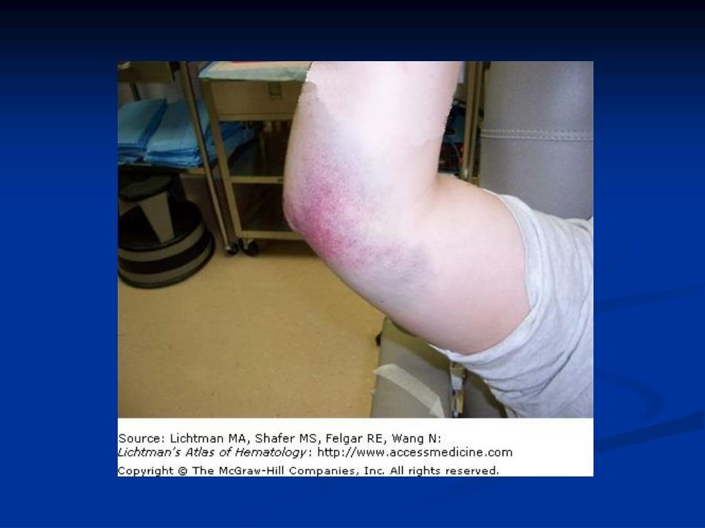

Slide 16
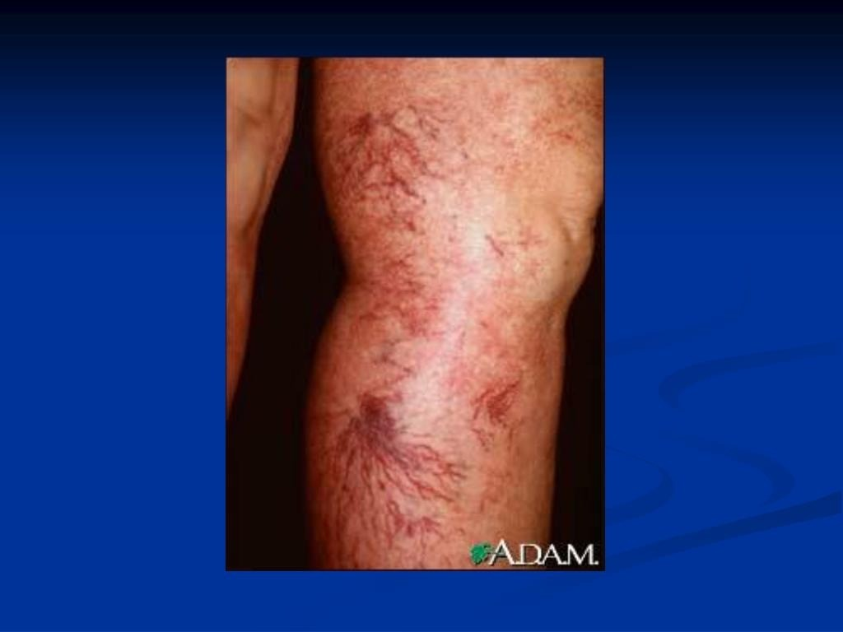

Slide 17
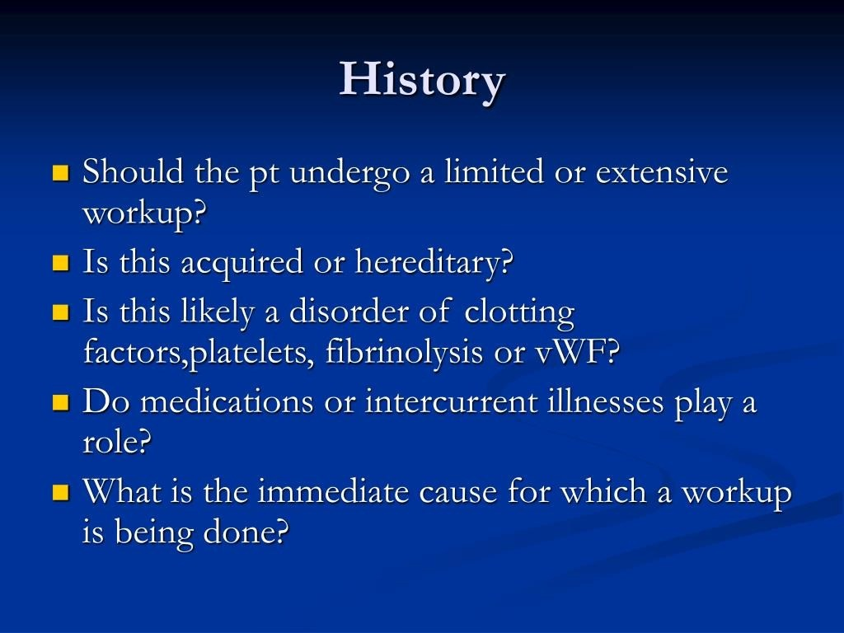

Slide 18
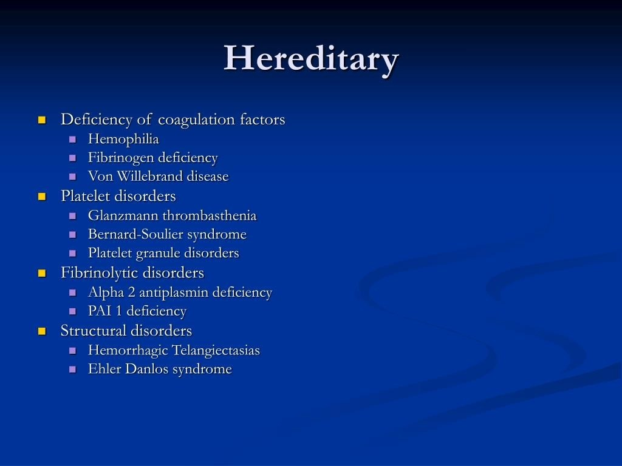

Slide 19
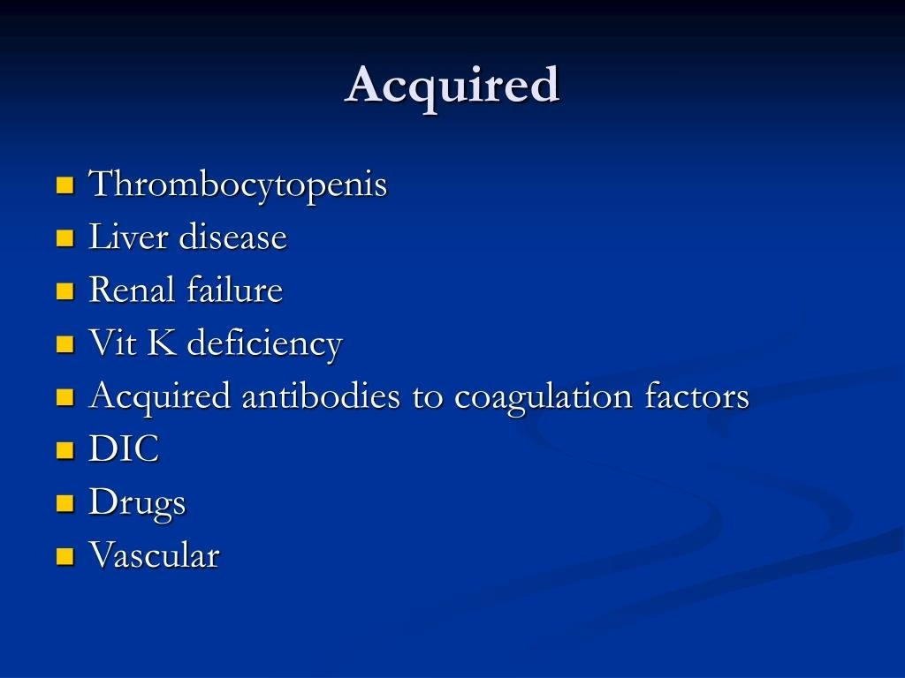

Slide 20
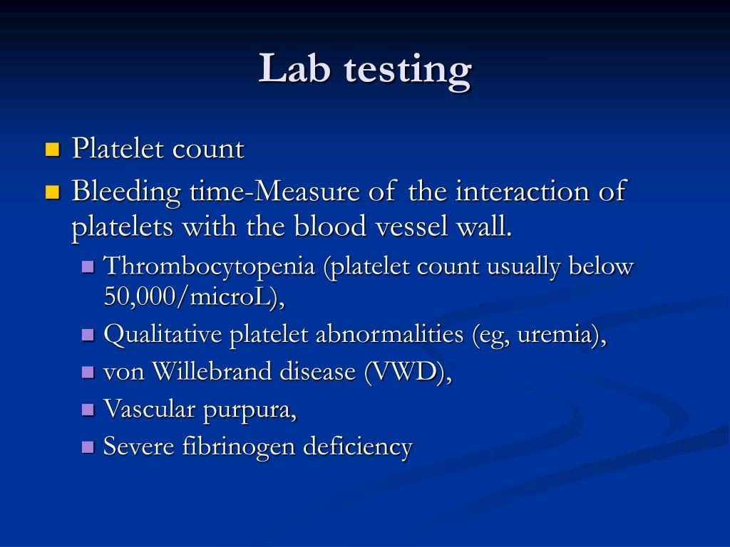

Slide 21
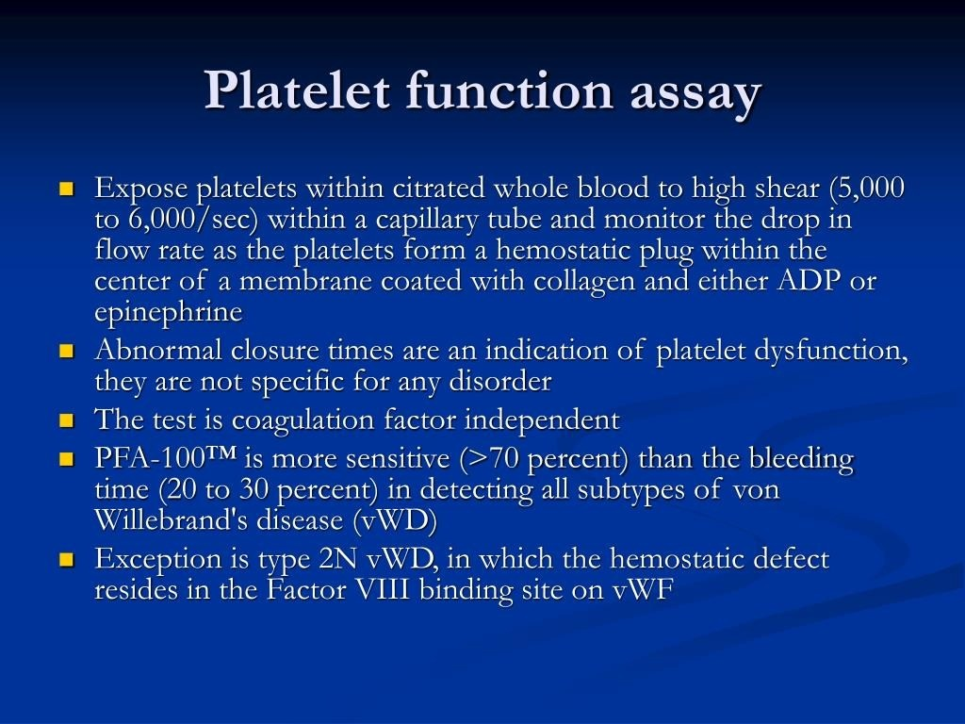

Slide 22
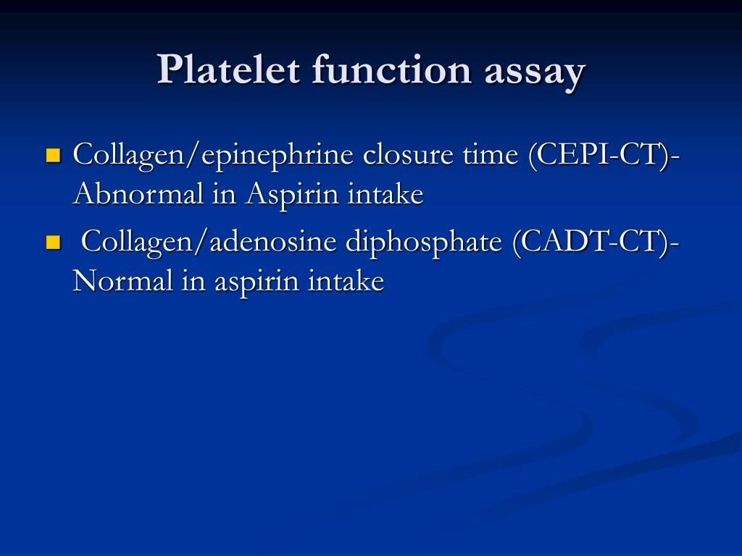

Slide 23
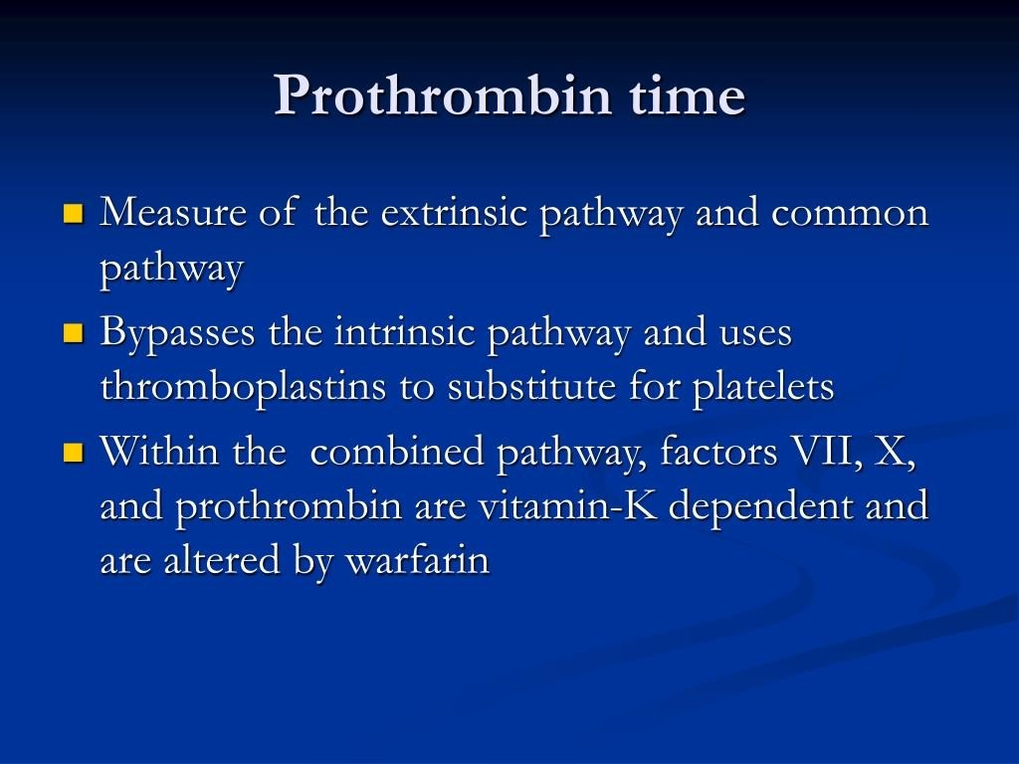

Slide 24
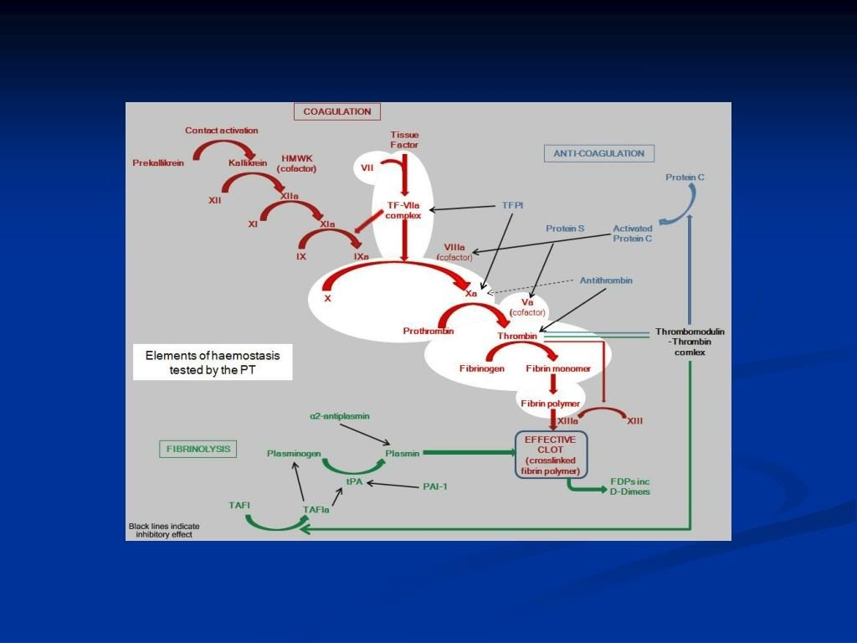

Slide 25
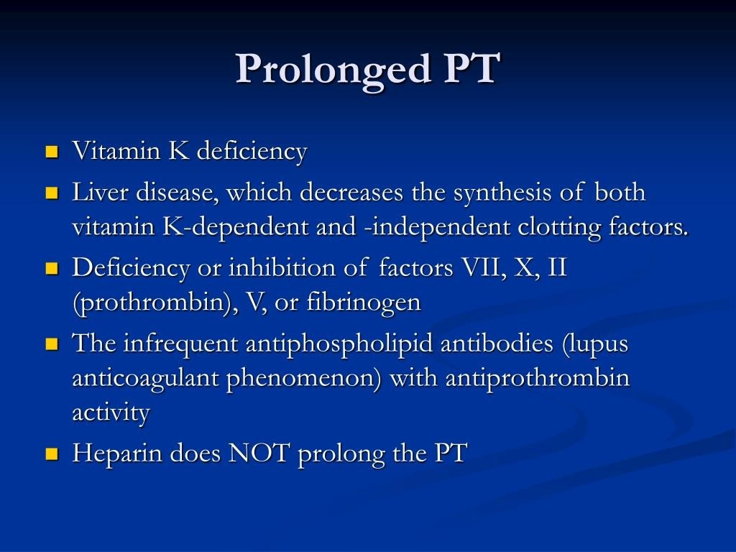

Slide 26
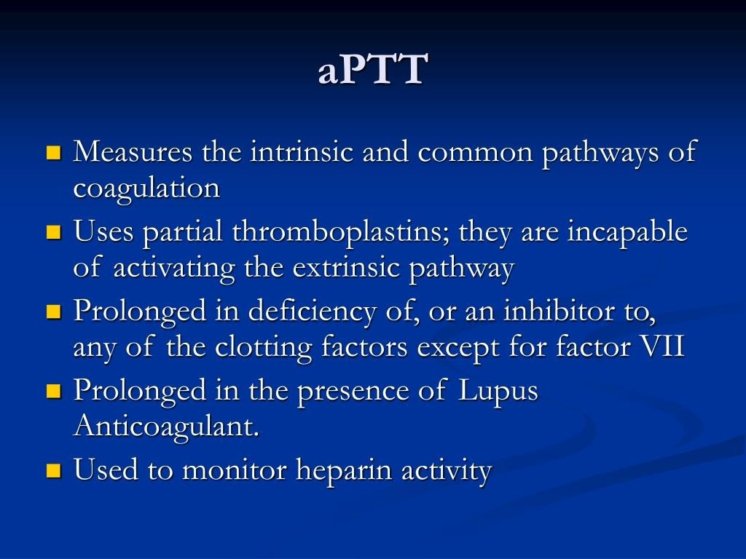

Slide 27
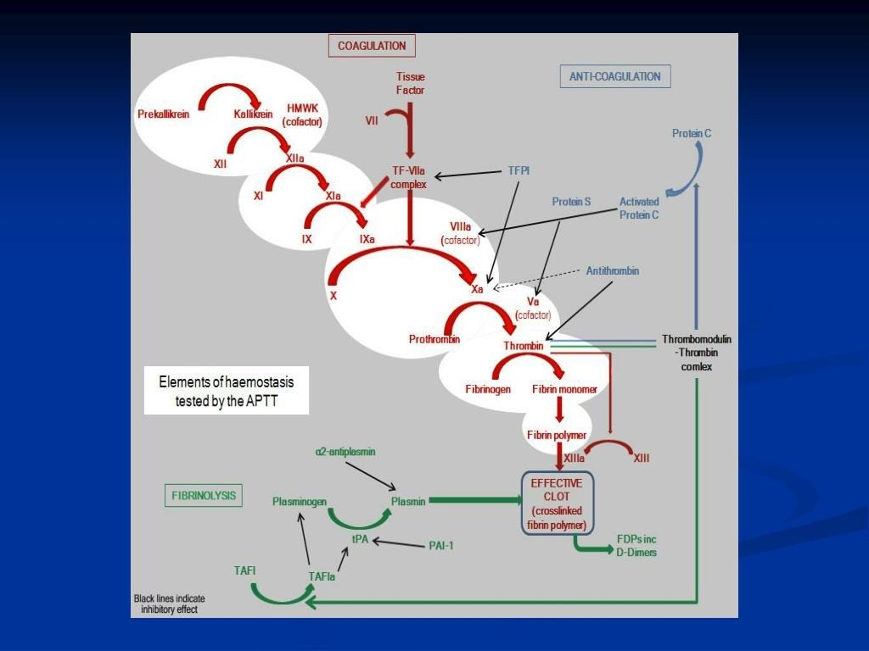

Slide 28
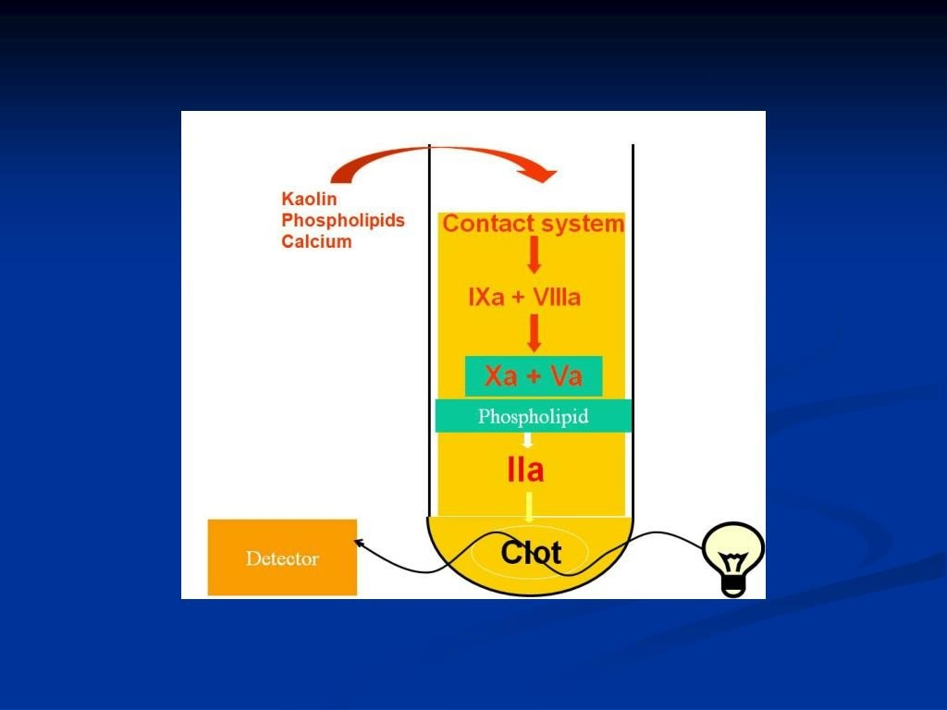

Slide 29
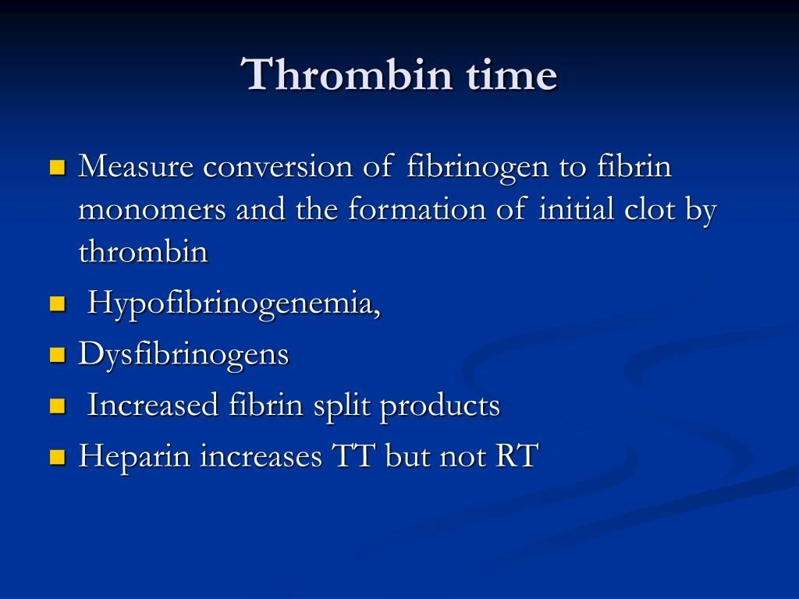

Slide 30
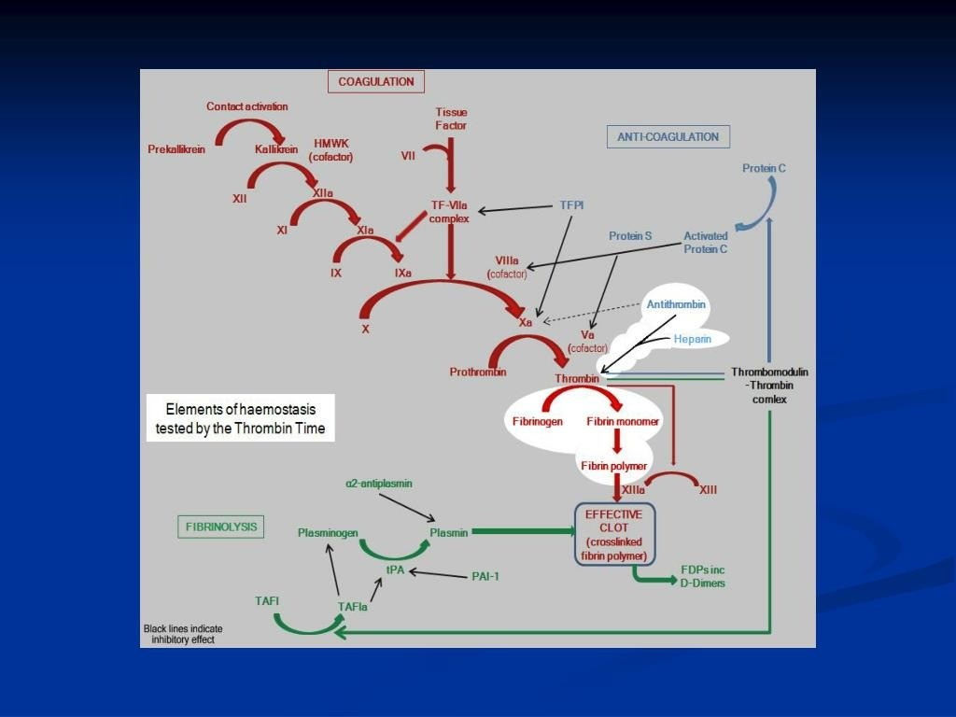

Slide 31
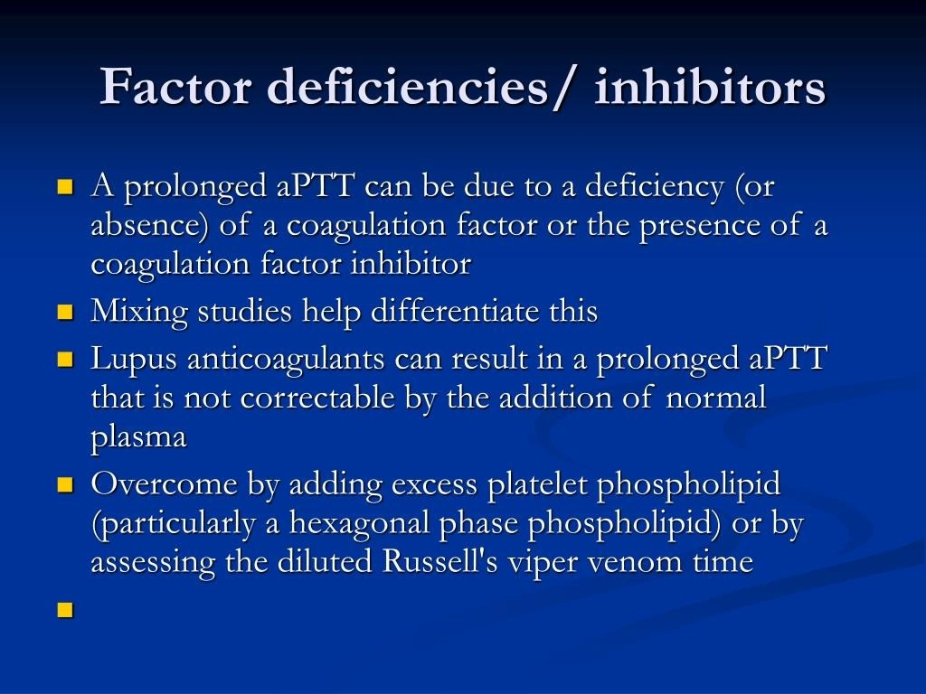

Slide 32
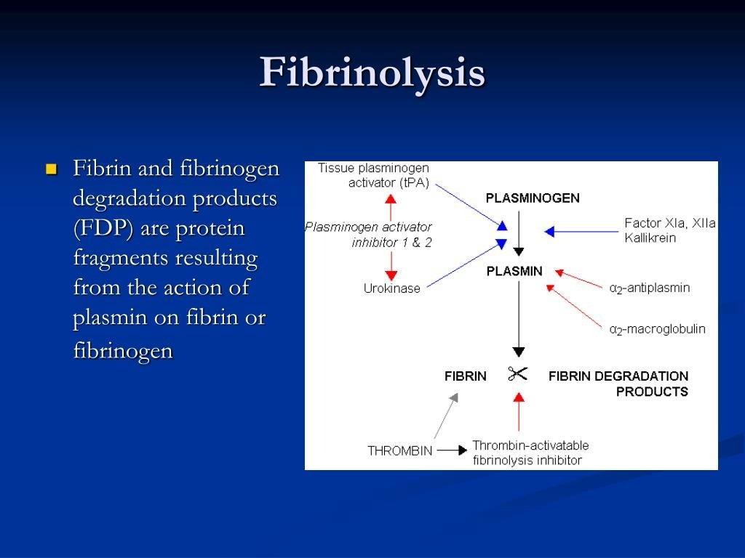

Slide 33
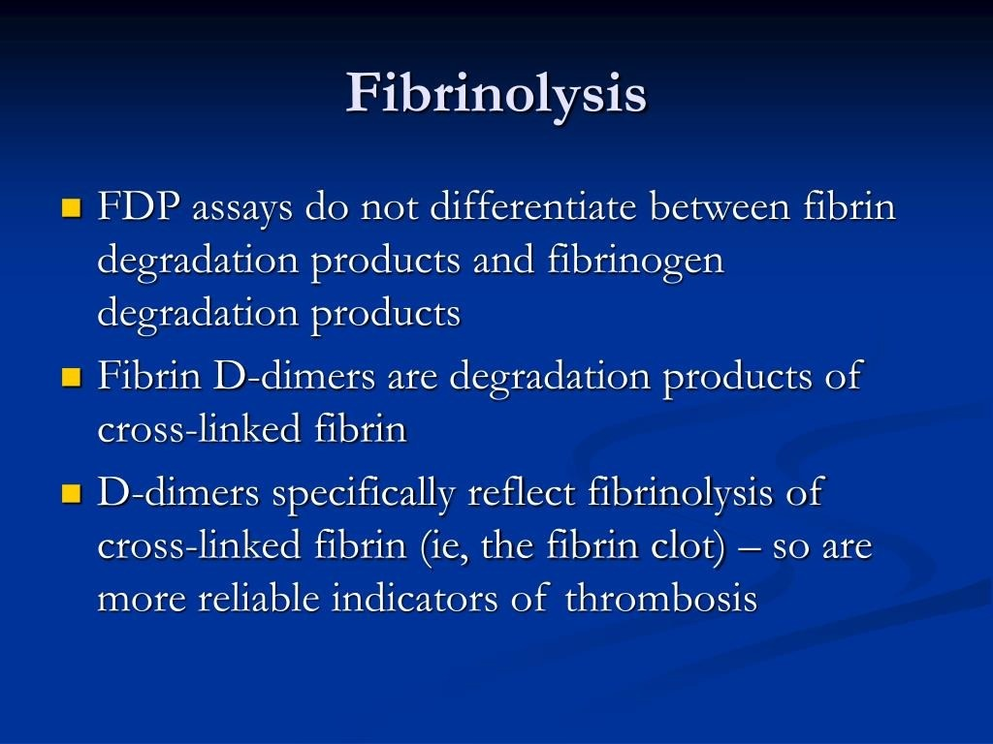

Slide 34
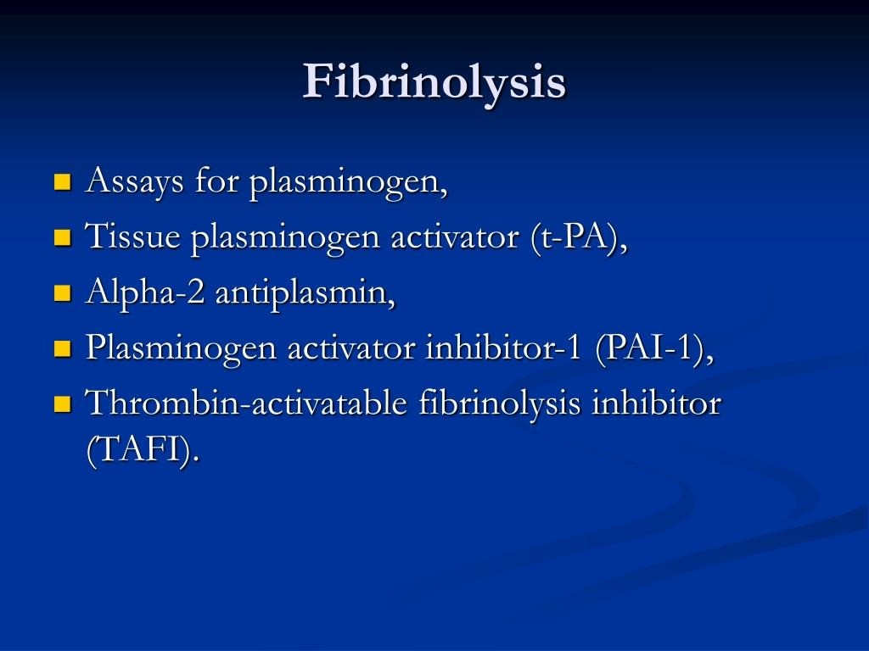

Slide 35
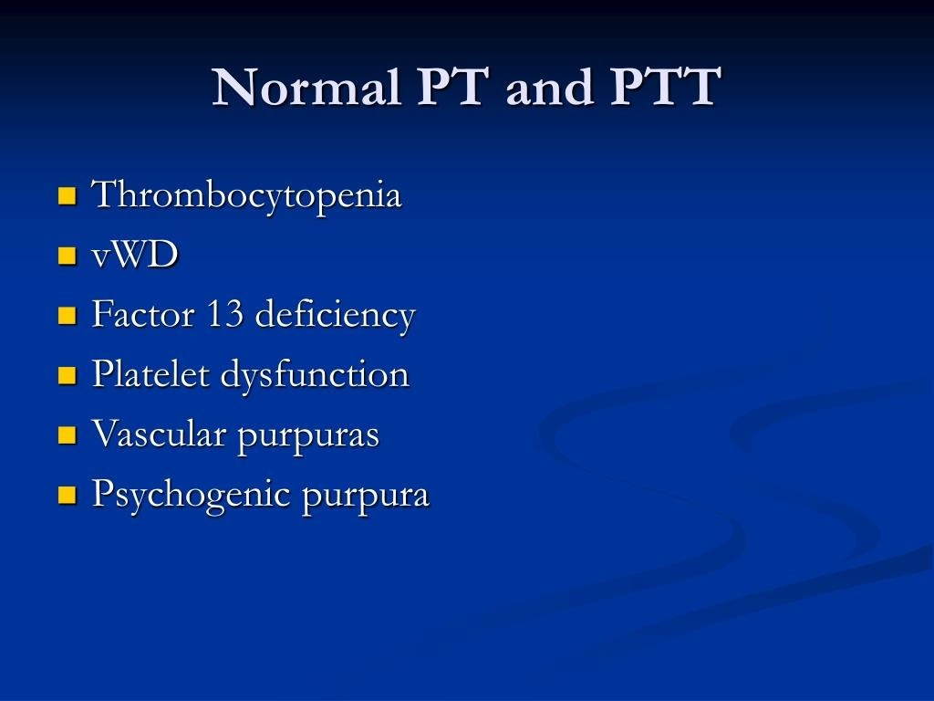

Slide 36
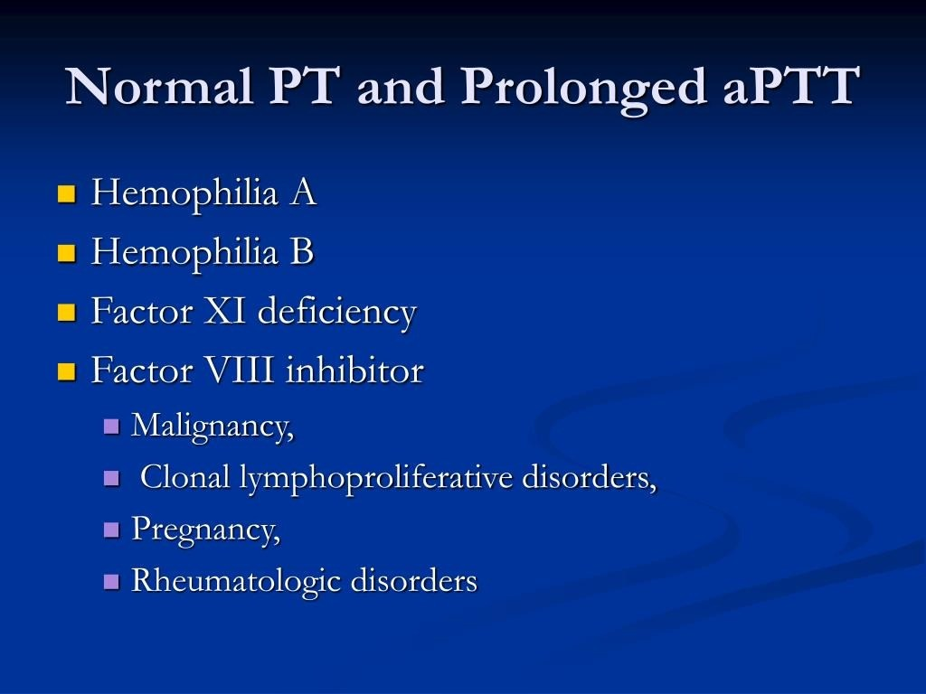

Slide 37
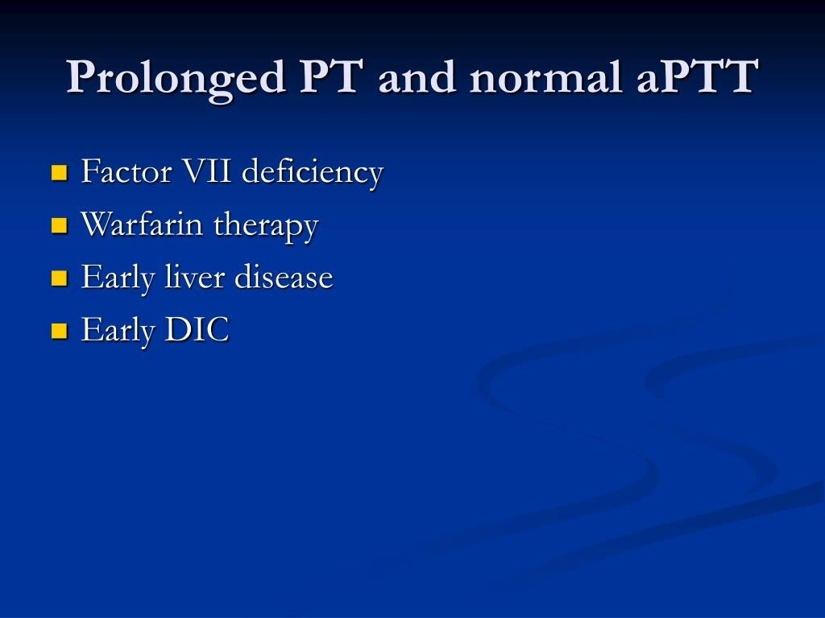

Slide 38
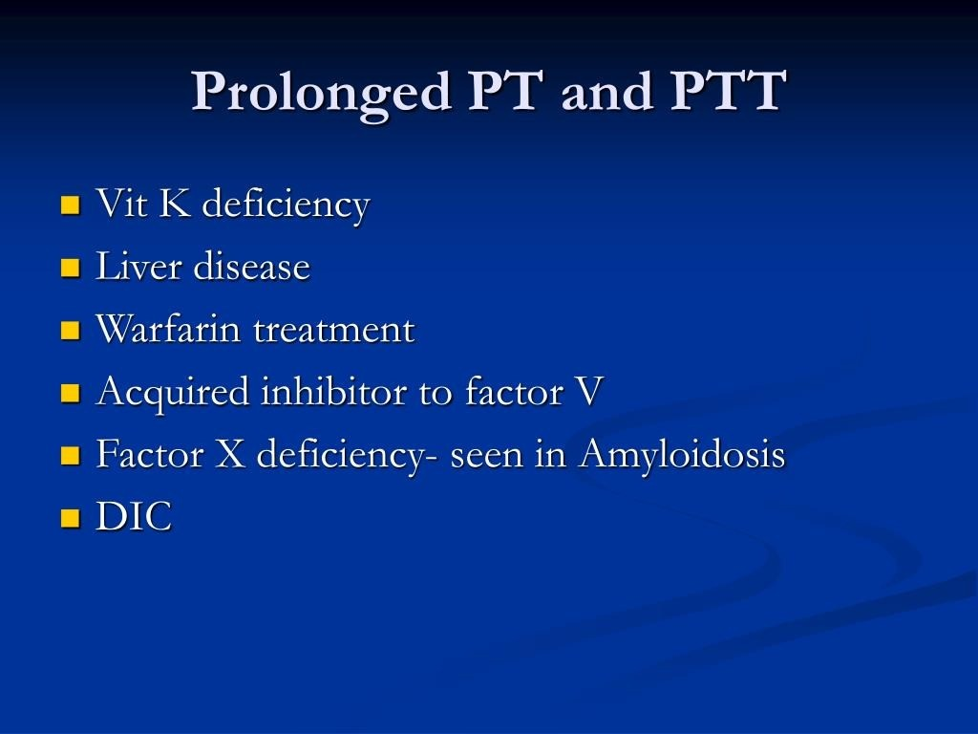

Slide 39
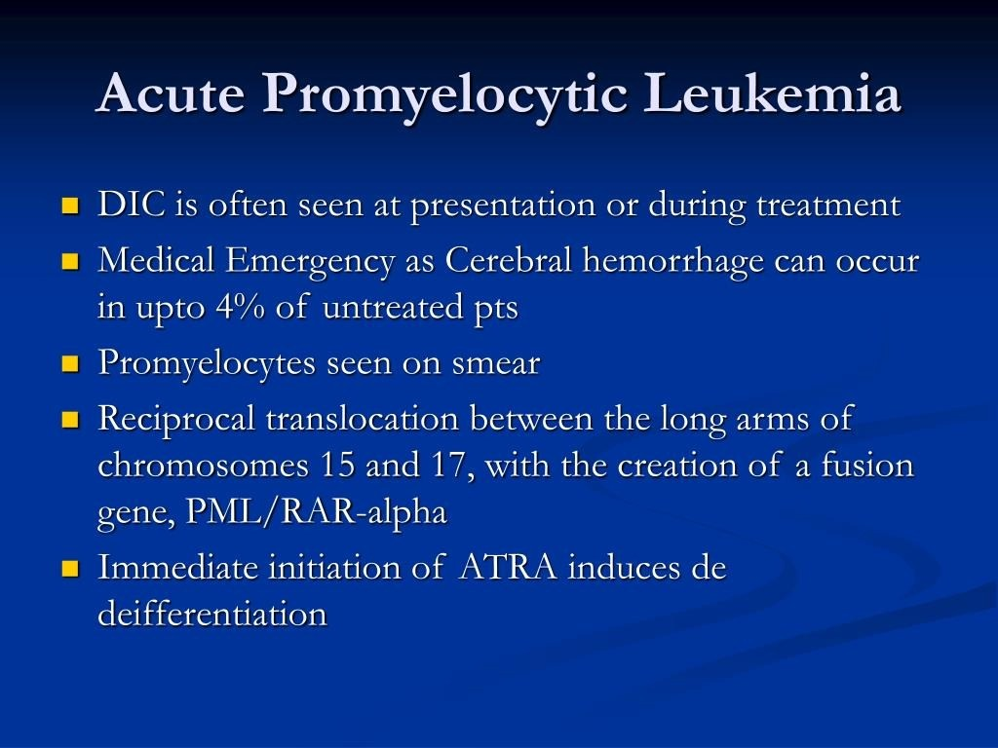

Slide 40
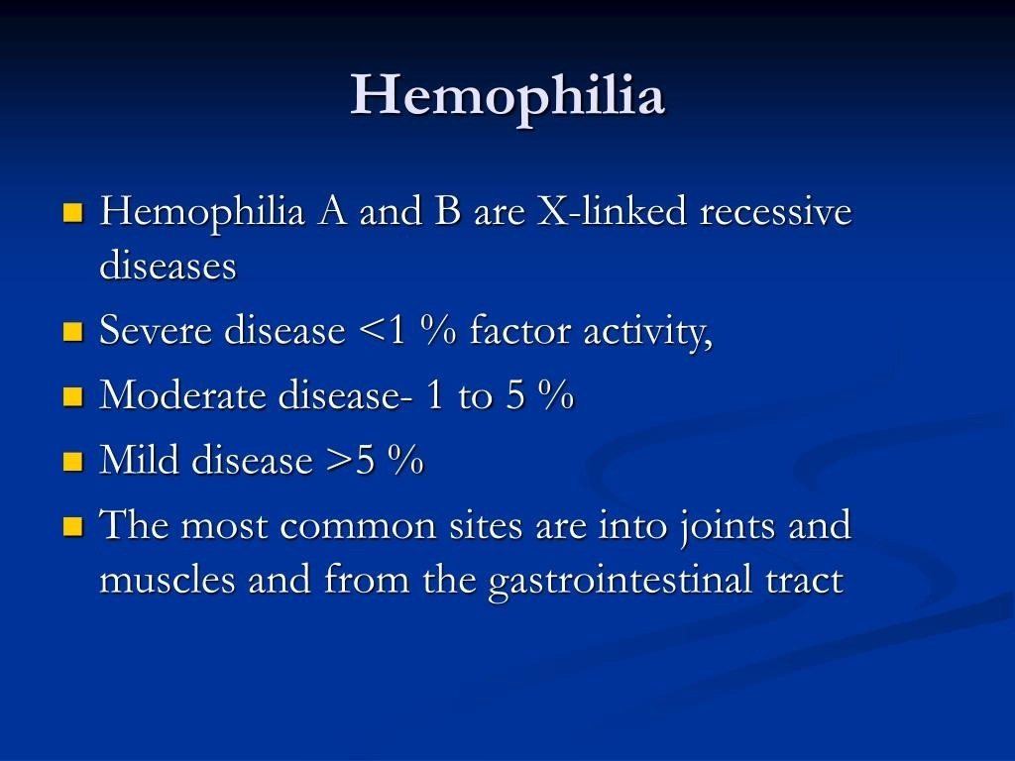

Slide 41
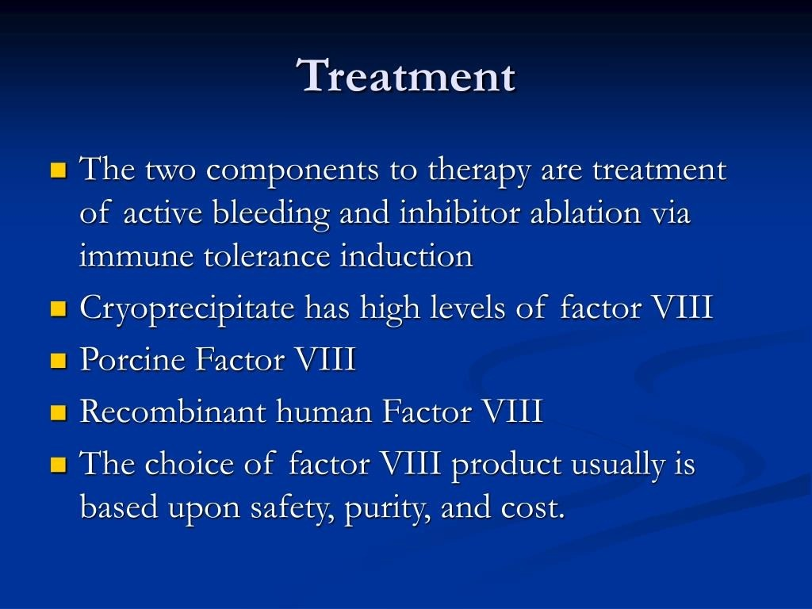

Slide 42
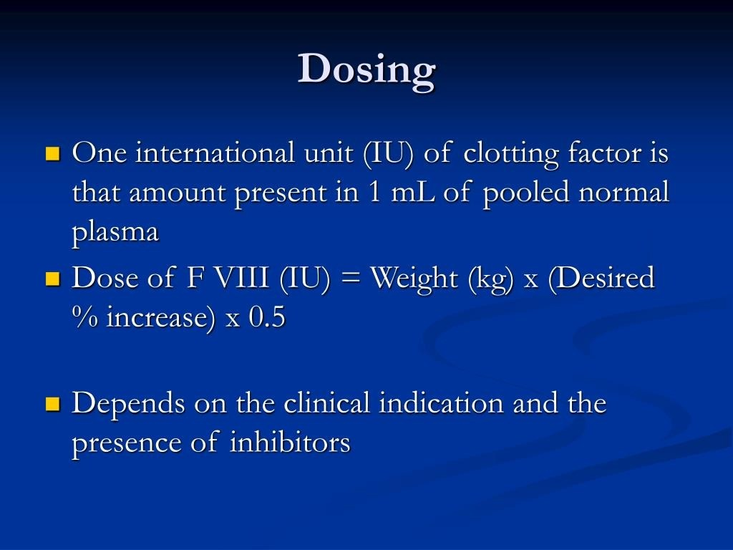

Slide 43
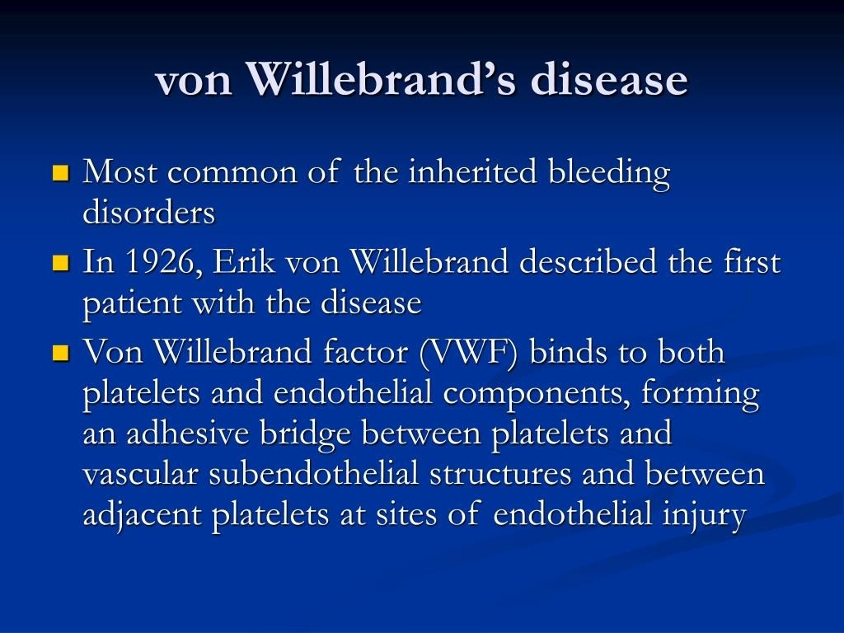

Slide 44
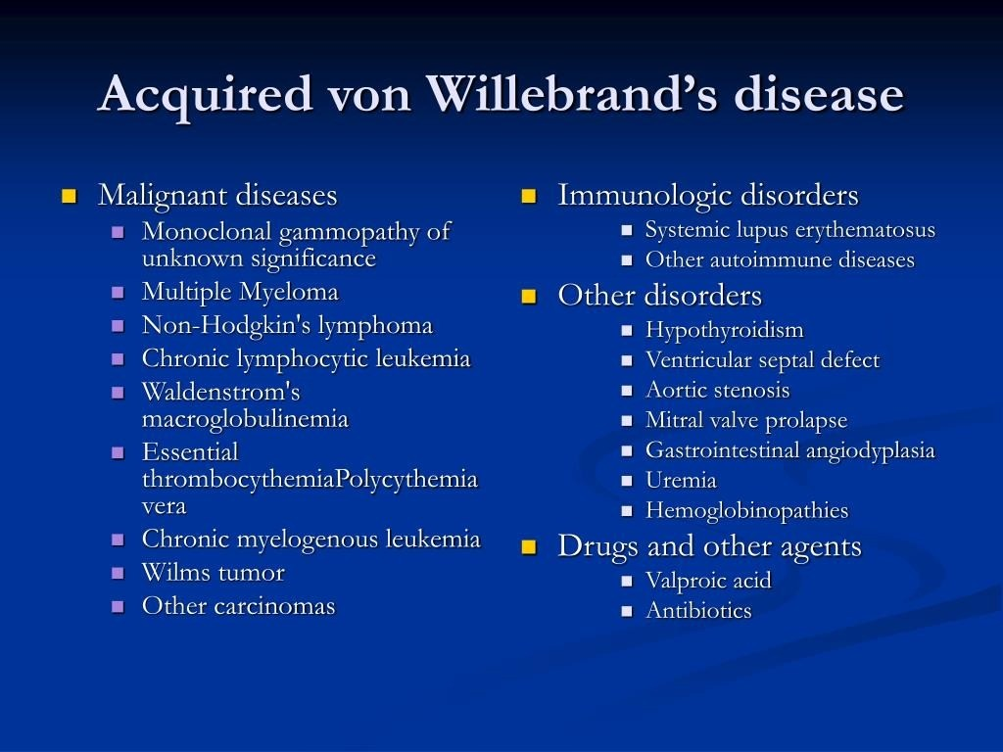

Slide 45
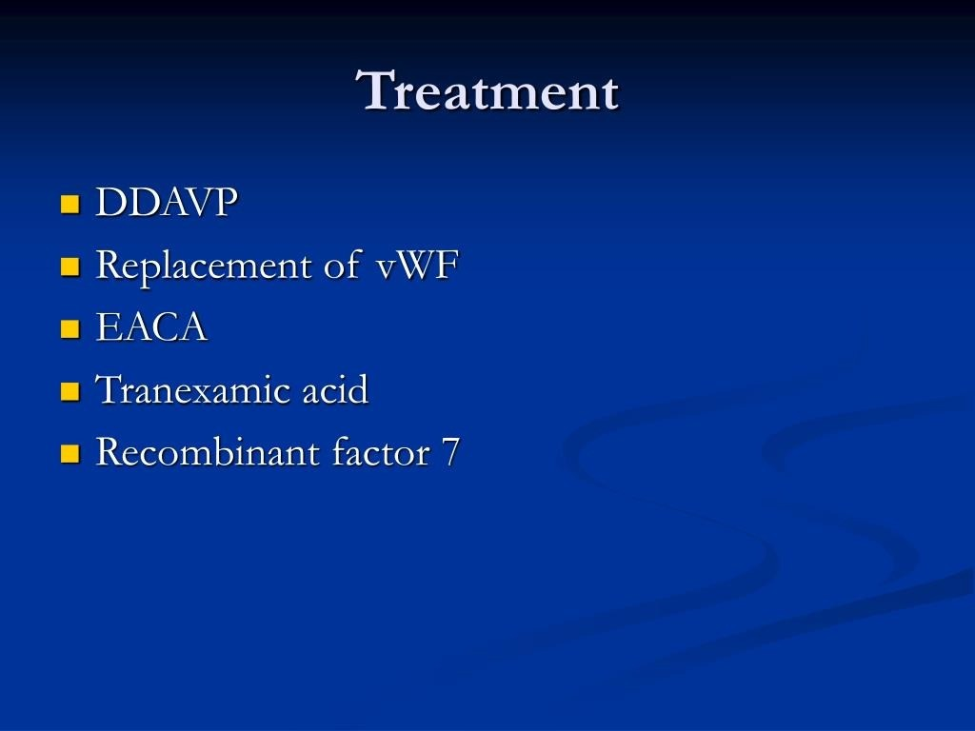

Slide 46
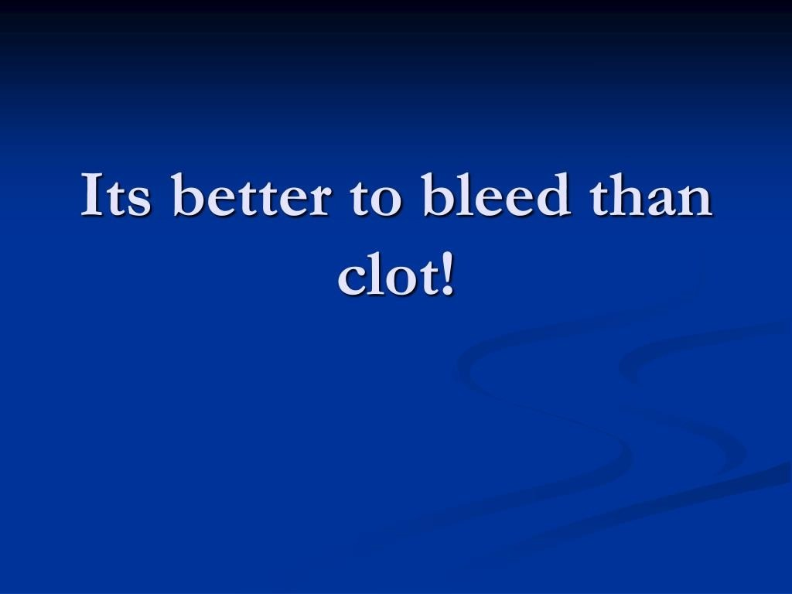

Slide 47
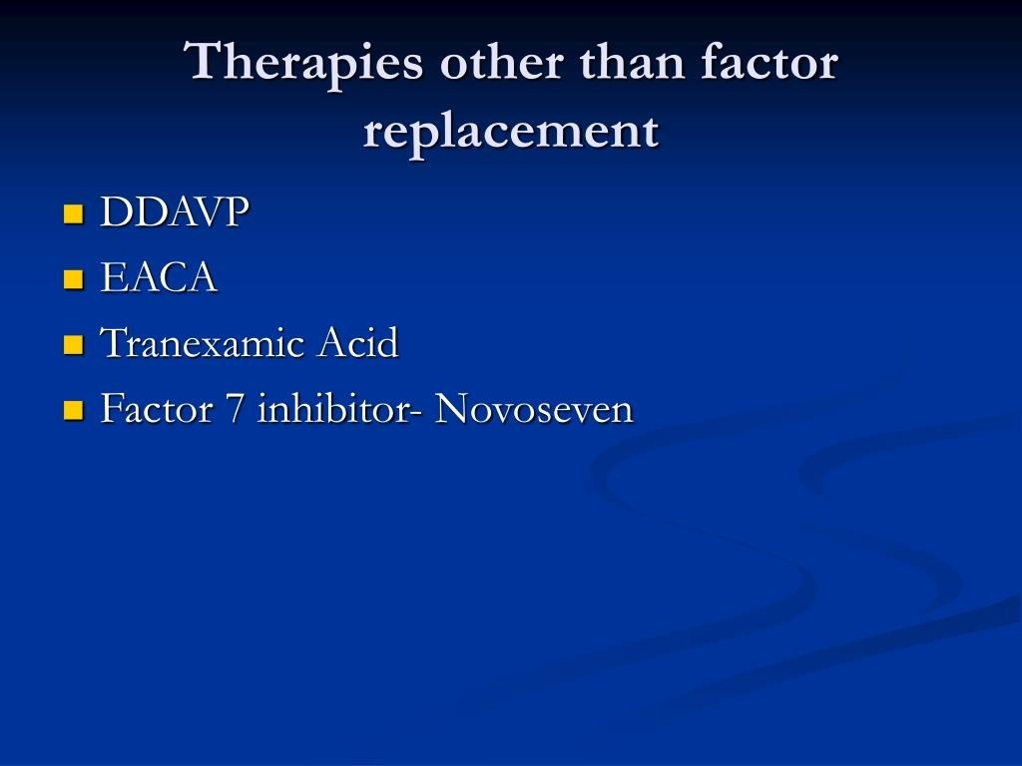

Slide 48
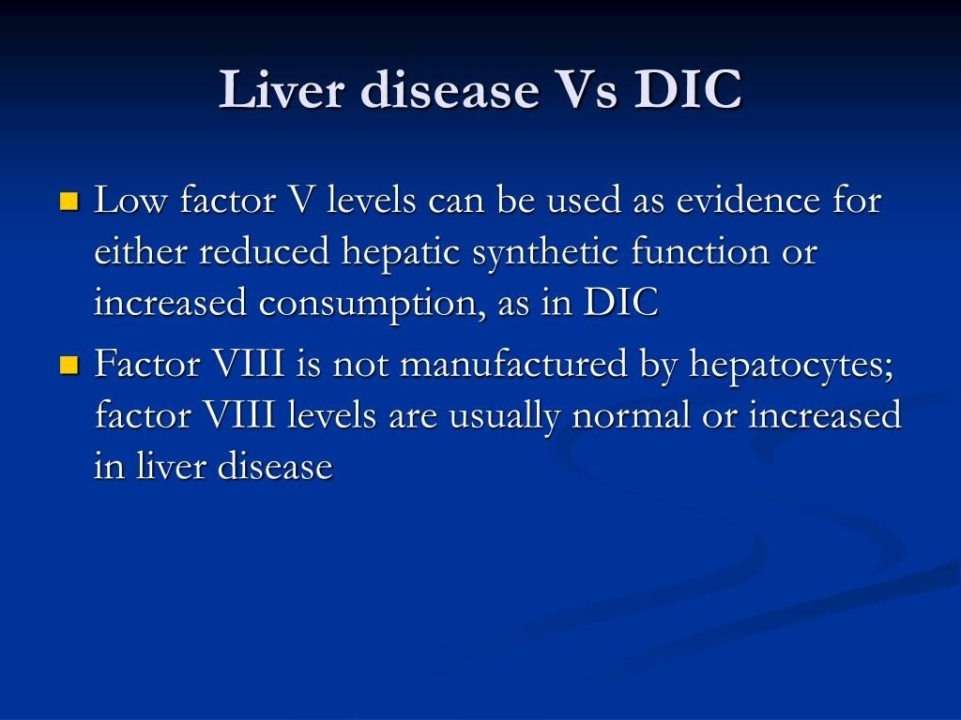

Slide 49
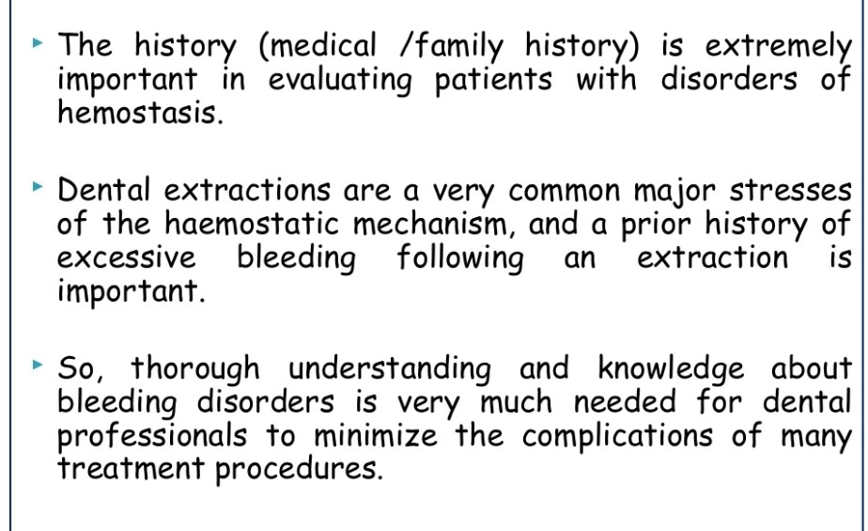
SUMMARY

Slide 50
REFERENCES
DAVIDSON’S PRINCIPLES AND PRACTICE OF MEDICINE; 23rd edition
HARRISON’S PRINCIPLE OF INTERNAL MEDICINE; 21ST edition
TEXTBOOK OF CLINICAL MEDICINE by S.N Chugh ;5th edition

Slide 51
QUESTIONS AND ANSWERS

Slide 52
THANK YOU.....

